Slide 1
Better visualizations for
crypto prices
Notes:
[Mandatory Slide] This would be the introduction slide of the topic that you are covering in this subsection.
When this slide plays, you could talk about the main aim that we’d be covering in this video.

Slide 2
In this Video, we are going to take a look at…
Candlesticks
MACD with Stockstats
Code sample: visualize candlesticks and MACD on crypto prices plots
Notes:
[Mandatory Slide]
Before the start of the video, we’d like to highlight what are important topics or pointers that we’d be covering in this video. This slide would immediately follow the intro/name slide. This would just be say 2-3 points for the viewers to know what they are getting into.

Slide 3
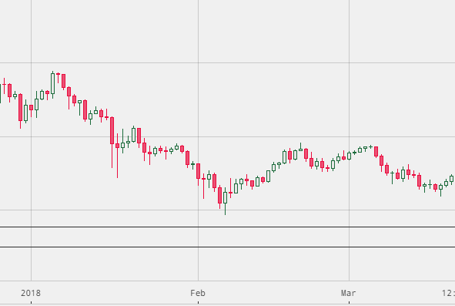
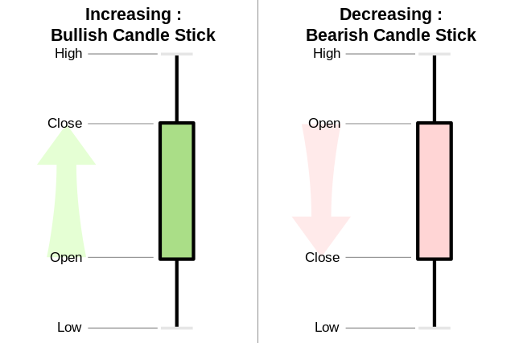
Candlesticks
Notes:
[Mandatory Slide]
Before the start of the video, we’d like to highlight what are important topics or pointers that we’d be covering in this video. This slide would immediately follow the intro/name slide. This would just be say 2-3 points for the viewers to know what they are getting into.

Slide 4
MACD with Stockstats (1/2)
Moving Average Convergence Divergence (MACD) is an oscillator showing the relationship between two moving averages of a price
MACD = EMA26 - EMA12
the “MACD signal”, which is an EMA9 of MACD is plotted on top of the MACD and acts as a trigger for buy and sell signals
also visualizing the histogram of the difference of MACD and MACD signal is useful, as it better conveys the above mentioned signals
There is an useful library called StockStats providing wrappers to Pandas DataFrames for stock data, with built-in statistics/indicators support. Install with:
pip install stockstats
df = pandas.read_csv('data.csv')
sdf = StockDataFrame.retype(df)
sdf['macd']
sdf['macds']
sdf['mac']
Notes:
[Mandatory Slide]
Before the start of the video, we’d like to highlight what are important topics or pointers that we’d be covering in this video. This slide would immediately follow the intro/name slide. This would just be say 2-3 points for the viewers to know what they are getting into.

Slide 5
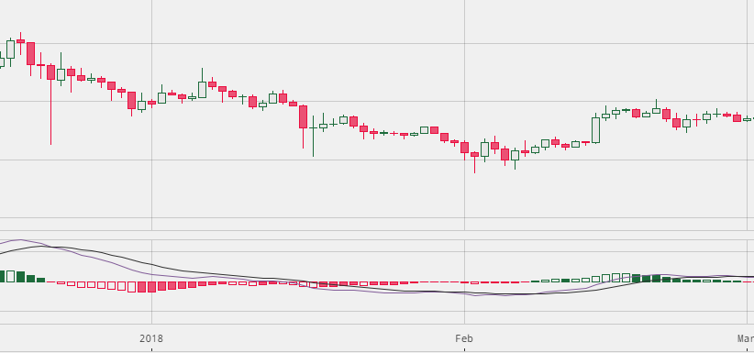
MACD with Stockstats (2/2)
Price candles
MACD
MACD signal
MACD histogram
(MACD - MACD signal)
Notes:
[Mandatory Slide]
Before the start of the video, we’d like to highlight what are important topics or pointers that we’d be covering in this video. This slide would immediately follow the intro/name slide. This would just be say 2-3 points for the viewers to know what they are getting into.

Slide 6
Code Sample:
visualize candlesticks and MACD on crypto prices plots
Notes:
Something that needs to grab the viewers attention!!

Slide 7
Summary
Candlesticks
MACD with Stockstats
Code sample: visualize candlesticks and MACD on crypto prices plots
Notes:
[Mandatory Slide]
Before the start of the video, we’d like to highlight what are important topics or pointers that we’d be covering in this video. This slide would immediately follow the intro/name slide. This would just be say 2-3 points for the viewers to know what they are getting into.

Slide 8
Revealing trends in crypto market
Next Video
Notes:
[Mandatory Slide]
Here the name of the next video needs to be mentioned. The narration as you guessed it would be just letting the viewer know exactly where we are at and what we’d be taking over next! ☺

